Slide 1
Welcome
All participants will be muted
Time for discussion will be allotted following specific sections and at the end
Type questions into the chat at any time throughout the webinar
Link to webinar recording and additional info will be posted at: www.utswmed.org/geneticstoolkit

Slide 2
March 25, 2020
Genetic Navigation:
Tools for Your Practice
Presented by: UT Southwestern Cancer Genetics
Moderator: Remington Fenter, MS, CGC

Slide 3

Genetic Navigation: Tools for your
Practice
UT Southwestern Medical Center is an
approved provider of nursing continuing
professional development by the Texas
Nurses Association an accredited
approver by the American Nurses
Credentialing Center’s Commission on
Accreditation.
This activity provides 1contact hour.

Slide 4
Genetic Navigation: Tools for your
Practice
Requirements for Successful
Completion
Learning Outcomes
Upon completion of this activity, nurses
will:
Sign in on the attendance roster
Provide email address –write legibly
Attend the entire activity*
Complete and submit the online evaluation tool within 2 weeks
•Obtain knowledge about genetic
testing criteria and management
recommendations
•Verbalize an understanding of the
importance of genetic navigation
Conflicts of Interest
•Demonstrate an understanding of
the navigation toolkit and other
available tools/resources to aid
with the creation/expansion of
genetic navigation services.
Conflicts of Interest among presenters
and planning committee members were
assessed and potential conflicts were
resolved prior to this event. No
commercial support has been received
for this activity. This is not a jointly
provided event.
•Identify ways of incorporating
genetic navigation into daily
practices with oncology patients.
*CNE credit will not be awarded for recorded version, it is a resource only

Slide 5
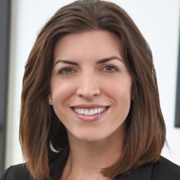
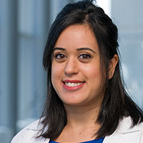
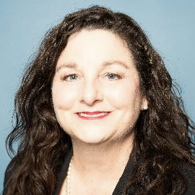
Speakers and Agenda
Introduction, Current Processes, and Initiatives
Needs Assessment and Barriers to Navigation
Leveraging Current Resources
Identifying Additional Resources
Q&A with presenters
Sara Pirzadeh-Miller, MS, CGC
Sayoni Lahiri, MS, CGC
Kathy Pratt,
BSN, RN, OCN, CBCN, ONN-CG

Slide 6

Genetic navigation program:
An overview
Sara Pirzadeh-Miller MS, CGC
Assistant Director, Cancer Genetics
UT Southwestern Medical Center
Sara.Pirzadeh@utsw.edu
Notes:
Sara Pirzadeh-Miller is Assistant Director of the Cancer Genetics program at UT Southwestern Medical Center in Dallas/Ft. Worth, TX. She leads 14 genetic counselors that provide hereditary cancer risk assessment with over 5,000 patients served annually.
She is currently a member of the National Society of Genetic Counselors (NSGC) Board of Directors and a past co-chair of the Cancer Special Interest Group (SIG) of NSGC. Her research interests include genetic counseling workforce efficiency, service delivery models and population screening.

Slide 7
How did we get here?
The Initial Need: funding genetic testing for underserved patients (county hospital systems)
  Susan G. Komen grants (2007-2010) – funded testing at Parkland/JPS clinics.
The Ongoing Need: better identification of high-risk patients in county hospital systems (and elsewhere) – and resources to do it!
The Idea: High throughput identification of high-risk patients in ‘general population’ settings (i.e. mammography clinics)

Slide 8
How did we get here?
The Questions:
  How do we screen patients in a robust way?
  What is the best way to inform patients of family history risk?
  Genetic service provision/testing?
  Routing high-risk patients to recommended follow-up?
  Tracking impact: compliance to follow-up? At-risk relatives ID’d?
Cancer Prevention and Research Institute of Texas – grants available starting 2010
  10% of funding towards prevention grants

Slide 9
History of UTSW Genetic Navigation Programs
CPRIT1 (Cancer Genetic Services for Rural and Underserved Populations in Texas – 2011-2015)
  Mammography population: family history screening for hereditary breast/ovarian cancer (Parkland/UTSW/rural counties)
  IHC screening of colorectal and endometrial cancers (Parkland/UTSW)
  Patient navigation: improve adherence to screening guidelines and uptake of risk-reducing procedures among the underserved genetic high risk.
  Telemedicine
  Population served: 6 North Texas counties (DFW and 4 western counties)
CPRIT2 (Population-Based Screening for HBOC and Lynch syndrome in the Underserved – 2014-2018)
  Expand mammography population to include more sites (JPS and 21 rural counties)
  Expand IHC screening of colorectal and endometrial tumors to underserved Fort Worth
  15 additional counties and multiple health systems. They are within an hour drive to one of four original UT Southwestern Cancer Genetics telemedicine locations.
  Patient navigation
  Telemedicine through mobile survivorship unit in Fort Worth
Detecting Unaffected Lynch Syndrome (DUAL – 2016-2020)
  Mammography and GI population screening for LS in Dallas county hospital and UTSW
  Family history of colon cancer screening for abnormal FIT result in Fort Worth and western rural counties (ages 50-74)
  Telephone-based genetic counseling service delivery with kit delivery from lab to patient home
  Patient navigation
  Promote recognition of Lynch syndrome in populations through many channels: educational campaigns, distribution of family history education cards in many clinical/lay population settings, etc.
Notes:
C1: Dallas/Tarrant/Wise/Hood/Johnson/Parker
C2: 15 additional counties and multiple health systems, including Bosque, Clay, Comanche, Cooke, Denton, Ellis, Erath, Hamilton, Hill, Jack, Montague, Navarro, Palo Pinto, Somervell, and Young County. They are within an hour drive to one of four original UT Southwestern Cancer Genetics telemedicine locations.

Slide 10
History of UTSW Genetic Navigation Programs
CPRIT Navigation: The use of a Genetic Patient Navigator to Increase compliance of gene mutation carriers with the NCCN guidelines and to promote health behaviors. (2016-2020)
  Increase compliance of HBOC patients to NCCN cancer risk management guidelines
  Increase compliance of LS patient to NCCN cancer risk management guidelines
  Increase identification of at-risk relatives of HBOC and LS probands
  Influence lifestyle behaviors to reduce cancer risk (targeting breast/colon cancers) by decreasing tobacco use and understanding breast cancer risk factors
  Expand awareness of HBOC/LS and GPN role and impact in clinical care within targeted populations
  Increase compliance to medical management guidelines to underserved patients with known HBOC/LS
The Dissemination of a Genetic Navigation Framework for Hereditary Cancers to Increase Mutation Carrier Identification and Improve Outcomes (2019-2021)
  Improve identification and care coordination of hereditary cancer with genetic navigation
    Establish high risk identification and navigation program in mammography program of partner institution
    Focus groups with partner institutions/groups throughout Texas
      Toolkit review, genetic navigation program discussions
  Creation of a resource toolkit on genetic navigation

Slide 11
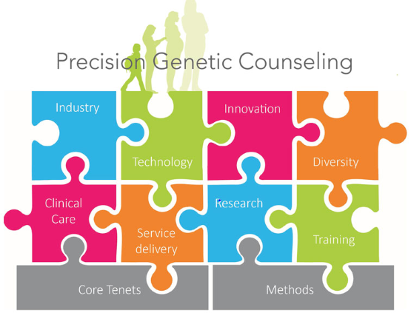
Considerations
Funding sources
Personnel
Process/ workflow
  Patient education
  Results disclosure
Test design
Technological resources
Cascade testing for at-risk relatives
Genetics expert
Barriers for underserved populations
Image: AJMGC

Slide 12
Step 1: Processes to identify at-risk patients
Method 1: Offer genetic testing to an unselected, healthy population
Method 2: Use screening criteria to identify a high-risk population; offer genetic testing to those who meet criteria
Possible criteria:
  Family history (NCCN) criteria;
  Risk-model thresholds;
  High-risk screening criteria,
  Tumor screening
Tools:
  Risk models
  EMR algorithms
  Mammography software
  Web-based HRA
  Questionnaires (paper/e-form, Mychart)
  Tumor evaluation
Notes:
Types of genomic/ genetic testing:
Whole genome testing
Whole exome testing
Panel-based testing

Slide 13
Step 2: After Identification: How to Inform and Follow-up?
Navigator personnel
  Job description
  Who could this be?
Methods for patient communication
  Phone call
  EMR-based messaging (MyChart)
  Emails (secure)
  Physician-led after program notifies in EMR

Slide 14
Step 3: Genetic Service Delivery
Who will be service providers?
  Genetic counselors, APPs, nurses, others?
  Handle pre/post test counseling, test order, result disclosure
  Within institution or external?
    Labs have genetic counselors (post-test), external genetic counseling provision companies
    If non-GC provider, educational opportunities to access training
      City of Hope, ASCO, NCBC
How will they deliver service?
  In person options
    1 on 1
    Group counseling
    Video education for pre-test
  Telemedicine/telephone
    Major help for underserved patient access

Slide 15
Step 4: Mutation identified – how to handle?
Cancer risks identified = specialist follow-up needed.
  Identify those resources in institution/community
  Opportunities for charity care?
Identification is half the battle – compliance!!
  Figure out how to track – technology
  What is compliance – how often screened, with what modality, surgical risk reduction uptake
  Non-compliance – how do you address?
    Navigator can help be a GC/clinic extender with the positive patients.
    Underserved settings a bigger need with additional barriers and SES issues.
Cascade testing: Family risk assessment
  Resources to facilitate – Kintalk, family letters, social media groups (family communication)
  Tracking cascade testing in program – infrastructure

Slide 16
Needs Assessment
& Toolkit
Kathy Pratt, BSN, RN, OCN, CBCN, ONN-CG
Genetic Patient Navigator
Cancer Genetics
UT Southwestern Medical Center
Kathy.Pratt@utsw.edu
Notes:
Kathy has been an oncology nurse for 35 years, having worked in inpatient & outpatient settings, nursing education, research, patient navigation, and currently in cancer genetics. She is an active member of the Oncology Nursing Society (ONS), the Academy of Oncology Nurse & Patient Navigators, serves on the Dallas Chapter ONS Board of Directors, and is the recipient of the Dallas ONS Founder’s Award, the DFW Great 100 Nurses Award, & D Magazine’s Excellence in Nursing for Oncology.

Slide 17

Objective:
Identify potential barriers to the implementation of a genetic navigation program and review the components of the Genetic Patient Navigation toolkit.

Slide 18
Needs Assessment: OCCUPATION

Slide 19
Needs Assessment:
OCCUPATION– “Other”
Clinical Educator
Genetic Counseling Assistant
Oncology Clinical Nurse Specialist
Private Practice
Research
Retired from Health System/ Clinical
Survivorship
Telehealth

Slide 20
Needs Assessment: TYPE OF ORGANIZATION

Slide 21
Needs Assessment:
TYPE OF ORGANIZATION– “Other”
Ambulatory Hospital Based Clinic Private Practice
Informed DNA Professional Nursing Organization
Insurance Private Medical Center
Navigation Software Development Research Center
Non Profit Clinic Telehealth
Physician-Owned Clinic VA- Government
Private Genetics Company– UM

Slide 22
Resources Required to Address Gaps
Additional staff
Funding
Training for current staff
Screening/ navigation tools
Standardized procedures
Technology resources
Local resources
Educational resources (patients, providers)

Slide 23
Needs Assessment:
RESOURCES NEEDED TO ADDRESS GAPS
Notes:
This is from Excel. REDCap does not allow a pie chart of this data.

Slide 24
Needs Assessment:
RESOURCES NEEDED TO ADDRESS GAPS-”Other”
“We have predominantly low-literacy patients who don’t speak English, so I am always looking for resources in multiple languages.”
“While my organization does not directly provide patient care, we are involved in training oncology nurses (of all types) and sharing resources that can be helpful to them in practice.”
“More space for the needed additional staff.”
Notes:
This is from Excel. REDCap does not allow a pie chart of this data.

Slide 25
Introduction of the Navigation Toolkit
*Kit includes tools to utilize existing resources and obtain additional resources.

Slide 26
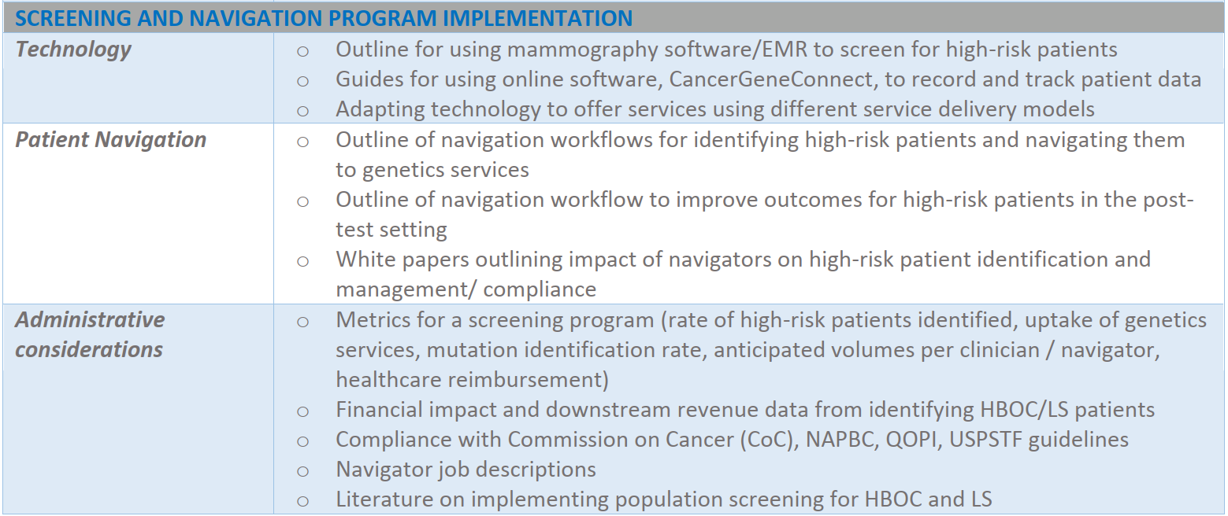
Toolkit Components:
Screening/ Navigation Program Implementation

Slide 27
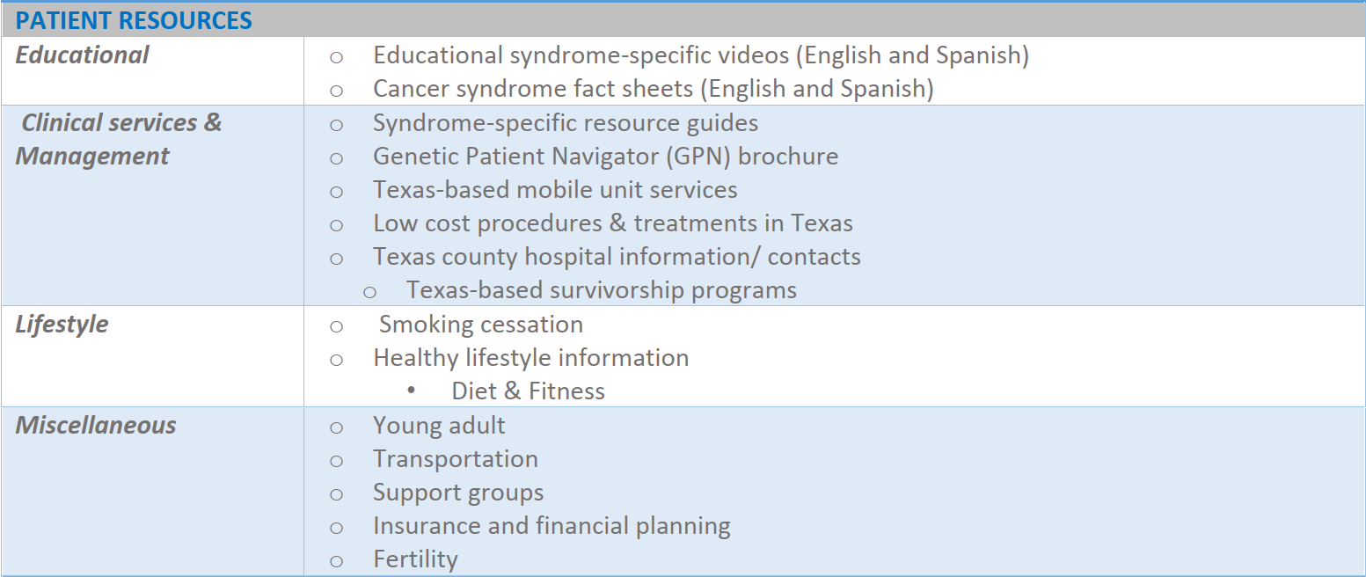
Toolkit Components: Patient Resources

Slide 28
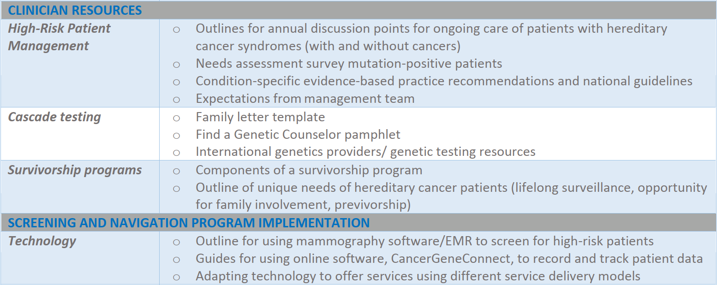
Toolkit Components: Clinician Resources

Slide 29

Discussion
Type questions into the chat
Notes:
Remington leads

Slide 30
Leveraging
Existing
Resources
Sayoni Lahiri, MS, CGC
Certified Genetic Counselor
UT Southwestern Medical Center
Sayoni.Lahiri@utsw.edu
Notes:
Sayoni Lahiri completed her Master of Science in Genetic Counseling at Northwestern University in Chicago in 2014. She then practiced genetic counseling in Orange, California before joining the UT Southwestern Cancer Genetics Department in 2015. In addition to providing genetic counseling for patients at risk for hereditary cancer at multiple UT Southwestern clinics, she is also grant coordinator and oversees two of the department’s population grants that focus on expanding access to genetic counseling and testing services to the underserved population of North Texas.

Slide 31




Outline Your Roadmaps & Fill in the Gaps
Population screening
Screening
tools
Clinician referrals
Screening
Self referrals
Awareness
Follow Up
Genetic Education/ Counseling
&
Genetic Testing

Slide 32


Impact of Patient Navigators
Screening
Awareness
Follow Up
Genetic Education/Counseling
&
Genetic Testing
Cascade Testing
Smoking Cessation
Compliance
Uptake & Completion of Genetic Counseling
33%
11%
13-20%
Up to 40%

Slide 33
Personnel
Screening
Genetic Education/ Counseling & Testing
Genetic Counselors
Physicians with genetics training/ knowledge
Advanced Practice Providers with genetics trainingNurses
Nurse navigators
Intake specialists/ schedulers
Medical assistants
Patient navigators
Genetic Counseling Assistants
Genetic Counselors
Physicians with genetics training/ knowledge
Advanced Practice Providers with genetics training/ knowledge
BASIC
GENETICS EDUCATION
Assess recorded patient/ family cancer history
Compare against specified qualification criteria
Determine who meets criteria & requires services
Record data appropriately
Provide hereditary cancer risk assessment: Identify differential diagnoses; Provide education about implications, risks, benefits, and limitations of genetic testing; Discuss cancer risk-management options; Discuss implications for family members
Provide psychosocial evaluation/ counseling
Determine appropriate genetic testing options: consider clinical/ financial considerations
Engage patient in decision-making
Interpret genetic testing results and make recommendations
SPECIALIZED
GENETICS TRAINING
GENETIC NAVIGATION
Awareness
Follow Up
Genetic Counselors
Physicians with genetics training/ knowledge
Advanced Practice Providers with genetics training/ knowledge
Nurses
Nurse navigators
Intake specialists/ schedulers
Medical assistants
Patient navigators
Genetic Counseling Assistants
Genetic Counselors
Physicians with genetics training/ knowledge
Advanced Practice Providers with genetics training/ knowledge
Nurses
Nurse navigators
BASIC GENETICS EDUCATION
Have a basic understanding of genetics/ hereditary cancer & genetic testing
Communicate the importance of genetic counseling/ testing to patients
Clarify reported personal/ family history
Record data appropriately
Be familiar with cancer risk-management guidelines for a variety of cancer predisposition genes
Be familiar with a variety of resources
Place referrals to appropriate specialists
Discuss follow up with patients & assess compliance to care
Identify barriers that decrease access to care
Connect patients to resources/ clinicians
Coordinate cascade testing for at-risk relatives
Educate patients about lifestyle and impact on cancer
DETAILED GENETICS
EDUCATION
GENETIC NAVIGATION
GENETIC NAVIGATION

Slide 34

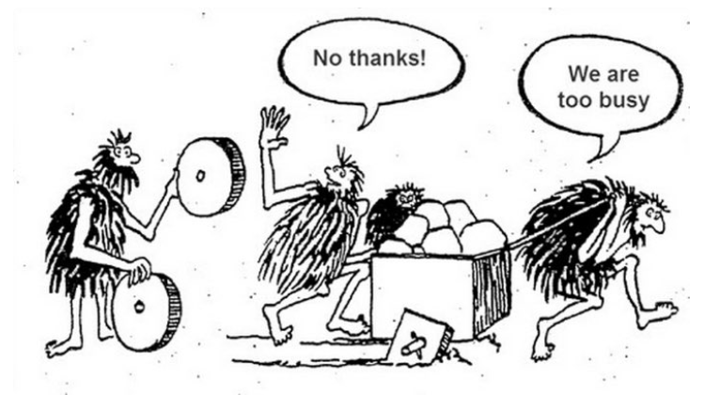
Leverage Existing Resources
Personnel for Genetic Navigation
Existing employees
  Identify those performing similar duties within your department/institution
  Adapt role and job description
  Provide appropriate genetics training/resources to perform duties
  Those in genetic counseling/education and follow up roles must have appropriate clinical training and background
Volunteers/ Interns (For screening/Awareness roles)
  May require HIPPA/ other training
  May only provide short-term commitment
Funding for Screening & Genetic Navigation
Existing institutional funds:
  Demonstrate need, benefits to stakeholders, anticipated outcomes, potential reach, downstream revenue generated
    Budget request
    Donor funds
    Cost-sharing with other departments
External funds:
  Grants: state agencies/ societies/ support groups
  Industry partnerships

Slide 35
Leverage Existing Resources: Tapping into Technology
Electronic Medical Record
Considerations for Non-Traditional Service Delivery
Develop algorithms to query personal/ family history and identify patients at high-risk for hereditary cancer
  Clinician enters data in EMR; Patient enters data in EMR
  Create automated lists of high-risk patients
Create high-risk registry to message patients/ clinicians
Create alerts to help clinicians identify high-risk patients
Run reports/ queries via EMR
Pre-test genetic education video
Telemedicine software: Skype for Business, Zoom, GoToMeeting
  HIPPA compliant; dowloadable software with secure links
Telephone genetic counseling/ Telemedicine genetic counseling
  Docusign to send information to patient
  Docusign for patient signature on consent documents
  Use genetic testing lab services to send saliva kits to patient’s home or coordinate mobile phlebotomy at patient’s home
Online survey distribution tools to develop compliance and needs assessment survey
  RedCap is secure and HIPPA compliant
Kintalk to securely send genetic testing results/ information to relatives for cascade testing
FindaGeneticCounselor.com to find local genetic counselors who provide in person/ telephone-based consultations across specialties
Mammography Software
Develop algorithms to query personal/ family history and identify patients at high-risk for hereditary cancer
  Clinician enters data
  Create automated lists of high-risk patients
Run reports/ queries
Online Data Collection & Tracking Platforms
Examples: CancerGeneConnect & Progeny
Electronically enter patient data/ family history & generate pedigrees
  Patients can enter data via patient portals
Run reports / queries for several variables & track patient status
Easily generate documentation for genetics consultations
Provide educational material to patients via patient portal
Order genetic testing
Run risk models
Web-Based Resources
Heredtary Cancer Risk Assessments to identify patients who require genetic evaluation
Several websites providing syndrome-specific/ general patient-friendly information and education
Web-based risk assessment tools (Tyrer-Cuzick, Gail, etc.)

Slide 36

Toolkit Resources
Guide for identifying genetics specialists
Software utilization guides
Genetics research information
Cascade
testing information
Electronic compliance/ needs assessment survey
Links to genetics training courses
Annual
clinical discussion guides
Risk management guidelines
Patient Identification
Educational website
Administrative Resources
Survivorship programs
Guides for alternate service delivery models
CME/ Educational videos
Resources for mobile units & low cost clinical services in TX
Clinical services
Educational Tools
Screening program metrics
Fact sheets
in English & Spanish
Literature
on genetic population screening programs
White paper
on impact of navigators
Patient Follow Up
Job descriptions
Downstream
revenue data
External specialists
Technology Guides
Genetic navigation process
guides
Family
history-based
screening tools
Genetic evaluation & testing criteria

Slide 37
Thinking forward:
Obtain
resources for
genetic navigation!
Sara Pirzadeh-Miller MS, CGC
Assistant Director, Cancer Genetics
UT Southwestern Medical Center
Sara.Pirzadeh@utsw.edu
Notes:
Do not reintroduce Sara

Slide 38

Who are your advocates?
Identify leadership in your institution
  Administration?
  Physicians/clinicians?
  Who supports secondary prevention?
    Genetics services
    Population screening

Slide 39

Funding opportunities
Within your institution:
  Foundation?
  Who coordinates donor/philanthropic giving efforts?
  How does your goal interface with the institution/center/donor interests?
  Partnerships which your institution is involved – opportunity?
    Ex. Southwestern Health Resources (UTSW/Texas Health Resources)

Slide 40
Funding Opportunities
Grant agencies
  National, state, local – survey the landscape
  National – NIH/NCI, PCORI
  State – CPRIT
  Local – Susan G. Komen chapters
Industry
  Working with private and academic imaging groups to screen family history
  Promotes testing through their product
  Consider pros and cons!
Notes:
Many industry are working with private and academic imaging groups to screen family history and promote testing through the lab – closed system.

Slide 41
Personnel
Who can perform the job description?
  Example: genetic navigator position – considered nurses, social workers, open to other healthcare providers
  Training:
    SOPs
    Technology acclimation
    Education on information and translation to layperson to ‘sell’ the importance of follow-up

Slide 42

Personnel
Consider paygrade
  Years of experience
  Impact to bottom line
If institution is focusing on navigation programs, try the ‘ask’ for a position
  How this feeds into the general mission?
  Start 0.25-0.5 FTE to build the internal case?
  If no navigation focus, you can still build a case!

Slide 43

Technology
Consider technology implications and needs through the genetic service spectrum
  Health risk assessment tools
    EMR – best practice alerts?
    Build health risk assessment tool on website
  Screening clinics – software and capabilities
  Electronic medical record system
    Screening clinic software data interface with EMR?
    Local example: Magview and Epic

Slide 44
Technology
Chatbots
  Use in population screening
  Screen prior to any healthcare provider appointment for high risk status
Apps/websites
  Reminders for high risk screening protocol
  Screening tool
  Education

Slide 45
Discussion
Type questions into the chat
Notes:
Remington leads

Slide 46
Thank you!
Evaluation survey and CNE/CEU information will be sent to the emails of all attendees
Toolkit and webinar recording at: www.utswmed.org/geneticstoolkit
Send any remaining questions to:
  CancerGenetics@utsw.edu
  Sara.Pirzadeh@utsw.edu
  Kathy.Pratt@utsw.edu
  Sayoni.Lahiri@utsw.edu

